Slide 1

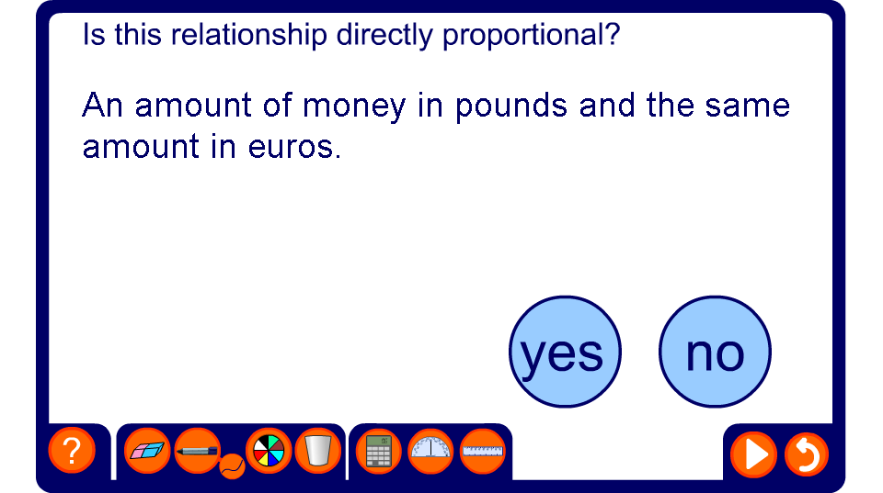


Are the following directly proportional?
Notes:
Establish that some situations may appear to be proportional because as one variable increases so does the other.
Test whether each of these examples are directly proportional by asking,
If one of the variables doubles, does the other one double?
If one of the variable is zero, is the other one zero?

